Slide 1
Road or rail transport?
You have five 13.6 m trailers.
ECC 310, ECC 312, ECC 315, ECC 320, ECC 325
They load in Malmö and unload in the following locations.
Compare road transport with intermodal rail transport
ECC 310 Grenna
ECC 312 Linköping
ECC 315 Västerås
ECC 320 Älmhult
ECC 325 Long harness

Slide 2
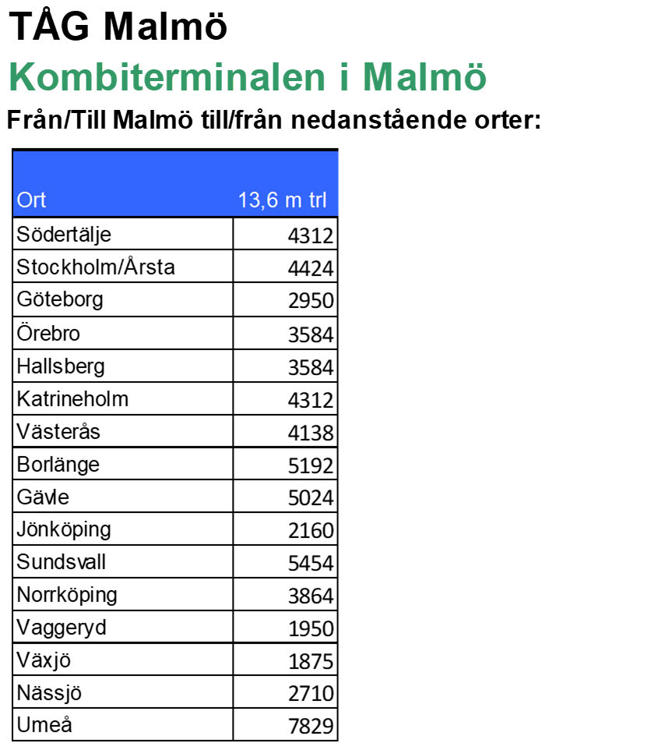
Road or rail transport?
ECC 310 Malmö - Gränna
Weight 33 miles x 98 = SEK 3,234 + 20% = SEK 647, total SEK 3,881
Forsling 750 SEK + Train via Jönköping 2160 SEK + Forsling 750 SEK total 3660 SEK
ECC 312 Malmö - Linköping
Weight 43 miles x 98 = SEK 4,214 + 20% = SEK 843, total SEK 5,057
Forsling 750 SEK + Train via Jönköping 2160 SEK + Forsling 2400 SEK total 5310 SEK
ECC 315 Malmö - Västerås
Weight 60 miles x 98 = SEK 5,880 + 20% = SEK 1,176, total SEK 7,056
Forsling 750 SEK + Train via Västerås 4138 SEK + Forsling 750 SEK total 5638 SEK
ECC 320 Malmö - Älmhult
Weight 15 miles x 98 = SEK 1,470 + 20% = SEK 294, total SEK 1,764
Forsling 750 SEK + Train via Växjö 1875 SEK + Forsling 1250 SEK total 3875 SEK
ECC 325 Malmö - Long harness
Weight 109 miles x 98 = SEK 10,682 + 20% = SEK 2,137 total SEK 12,819
Forsling 750 SEK + Train via Sundsvall 5454 SEK + Forsling 2400 SEK total 8604 SEK

